Slide 1
DPM - Week 1
William Bouchard
Yanis Jallouli
Andy Li
Trevor Tabah
Ben Weiss
Seyed Yazdan Zinati

Slide 2
Group Roles
Role | Leader | Aided By
Project Manager | Ben Weiss
Documentation Manager | Andy Li | Trevor Tabah
Software Engineer | William Bouchard | Ben Weiss
Hardware Engineer | Seyed Yazdan Zinati
Test Engineer | Yanis Jallouli | Trevor Tabah

Slide 3
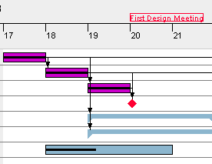
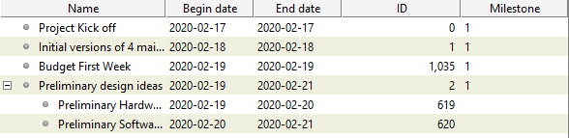
GANTT Chart
Weekly Tasks
Update 4 Documents lead by Andy
Input hours in Excel, everyone involved
Update Gantt Chart lead by Ben*
Weekly Design Meeting 30mn, everyone
General Tasks: Assigned based on roles
*Items that have been updated to reflect actual time spent coloured purple

Slide 4
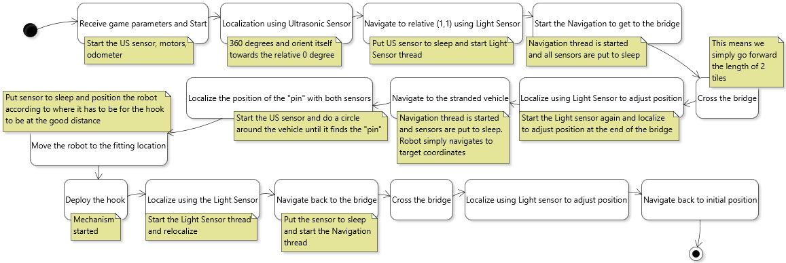
Current Ideas - Software
A general overview of the final robot’s task flow

Slide 5
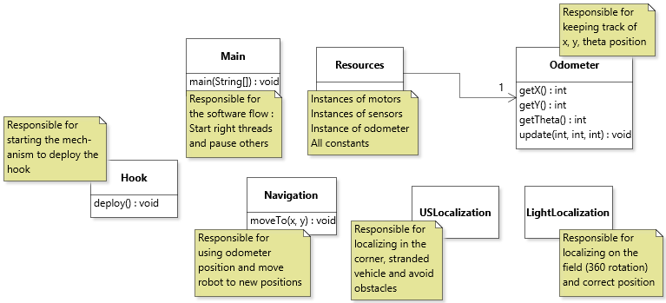
Current Ideas - Software
A preliminary sketch of the required classes

Slide 6
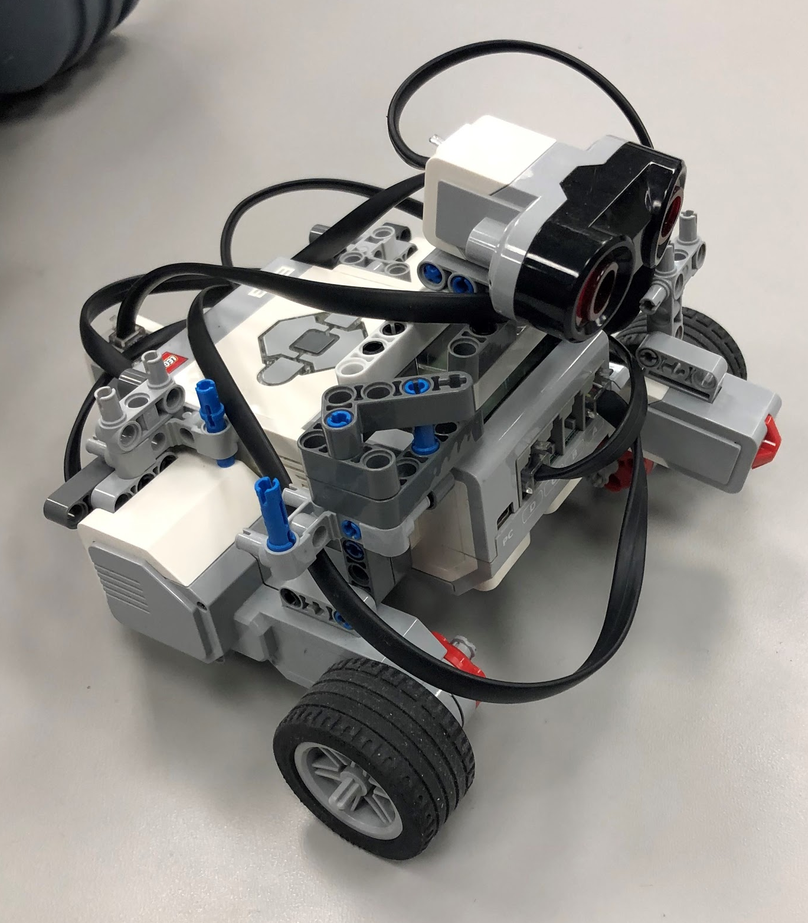
Current Ideas - Hardware
Stay simple - add upon commonly used designs
Light sensor needed around the front to detect color (the picture uses a touch sensor in its place for visualization)
Moving pieces would be needed to latch onto the cart’s hole
Common robot design - able to navigate.
Can be extended/altered for this project

Slide 7
From Here
Mechanical Design - Create at least 3 alternative designs with pros and cons
  Developed by Yazdan
  Tested by Yanis
  Analyzed by Trevor
Preliminary Software Architecture - Describe the overall software system
  Developed by William with help from Ben
  Tested by Yanis and Trevor
Update the budget and GANTT Chart
  Covered by Ben and assisted by Andy
Documentation - Create and format all required documentation
  Done by Andy in conjunction with the respective members (for Hardware, Software, and Testing)

Slide 8
Questions?

